Slide 1
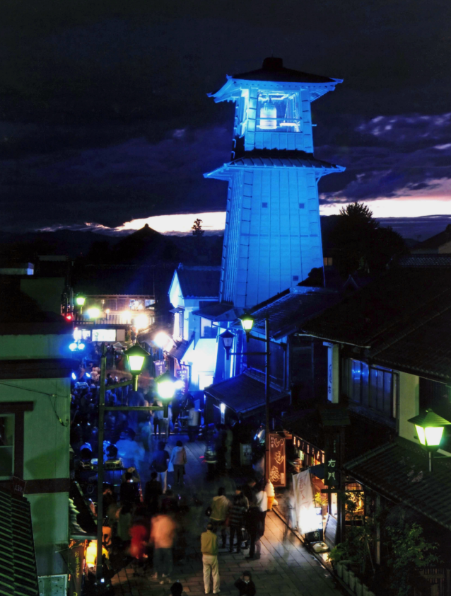

Measurement of insulin resistance in clinical practice: use of OGTT based techniques
Plenary Lecture
46th Annual Conference of Endocrine Society of India
Blue Lighting at Kawagoe
Chairpersons: Dr. K K Gupta, Dr. Parminder Singh
Hotel Pullman New Delhi Aerocity
Asset No 02 GMR Hospitality District, New Delhi, 110037
TEL: +91 11 4608 0808
23rd October 2016 9.45 -10.15 am
Department of Endocrinology and Diabetes,
Saitama Medical Center, Saitama Medical University
1981 Kamoda, Kawagoe-shi, Saitama-ken, Japan
Matsuda, Masafumi MD, PhD
November 14, 2009
Endocrine Society of India

Slide 2






CV
Masafumi Matsuda, MD, PhD
Research Field:
Metabolism, Endocrinology, Insulin action, Regulation in hypothalamus
Professional Experience
Resident: University of Tokyo Hospital (Hongo, Tokyo, Japan, 6/10/1982)
Resident: University of Tokyo Hospital Branch (Meziro, Tokyo, Japan, 1/10/1983)
Assistant: Internal Medicine, Yamaguchi University (Ube, Yamaguchi, Japan, 6/1/1987)
Physician: Saiki Hospital (Nagato, Yamaguchi, Japan, 6/1/1988)
Clinical Instructor: Diabetes Division, UTHSCSA (San Antonio, Texas, USA, 3/1993)
Instructor: Diabetes Division, UTHSCSA (San Antonio, Texas, USA, 9/1/1994)
Assistant Professor of Medicine: Diabetes Division, UTHSCSA (San Antonio, Texas, USA, 9/1/1996)
Medical Research Director, Clinical Research Center, Texas Diabetes Institute (1997)
Lecturer, Diabetes Division, Internal Medicine, Kawasaki Medical School, Kurashiki, Okayama, Japan (1/1/1999)
Lecturer, Endocrine and Diabetes Division, Internal Medicine, Kawasaki Medical School, Kurashiki, Okayama, Japan (4/1/2000)
Director, Diabetes and Endocrine Department, Kameda Medical Center (1/1/2006)
Professor, Department of Endocrinology and Diabetes, Saitama Medical Center, Saitama Medical University (4/1/2009-present)
Degree, Licensure and Certification
Faculty of Medicine, The University of Tokyo, Bachelor of Medicine [M.D.]
Doctor of Medical Science, Yamaguchi University [Ph.D.]
Medical Examination of National Board (Japan)
Board Certificate and Certified Physician for Residency Training in Internal Medicine, Diabetology, Endocrinology and Metabolism (Japan)
Fellow of the Japanese Society of Internal Medicine
Standard ECFMG Certificate (USA) USMLE Step 1, Step 2 and Step 3 passed (USA)
Works original articles 117 (total citation: 7220, h-index: 33 from Scopus)
Matsuda M, DeFronzo RA : Insulin sensitivity indices obtained from oral glucose tolerance testing: comparison with the euglycemic insulin clamp. Diabetes Care 22:1462-1470, 1999. (citation:>2600)
Matsuda M: Management of glucose levels in the hospital – theory and practice, Kanehara Ltd. Tokyo, Japan

Slide 3
DISCLOSURE
Presenter: Masafumi Matsuda, MD PhD
The authors have no financial conflicts of interest to disclose concerning the presentation.

Slide 4
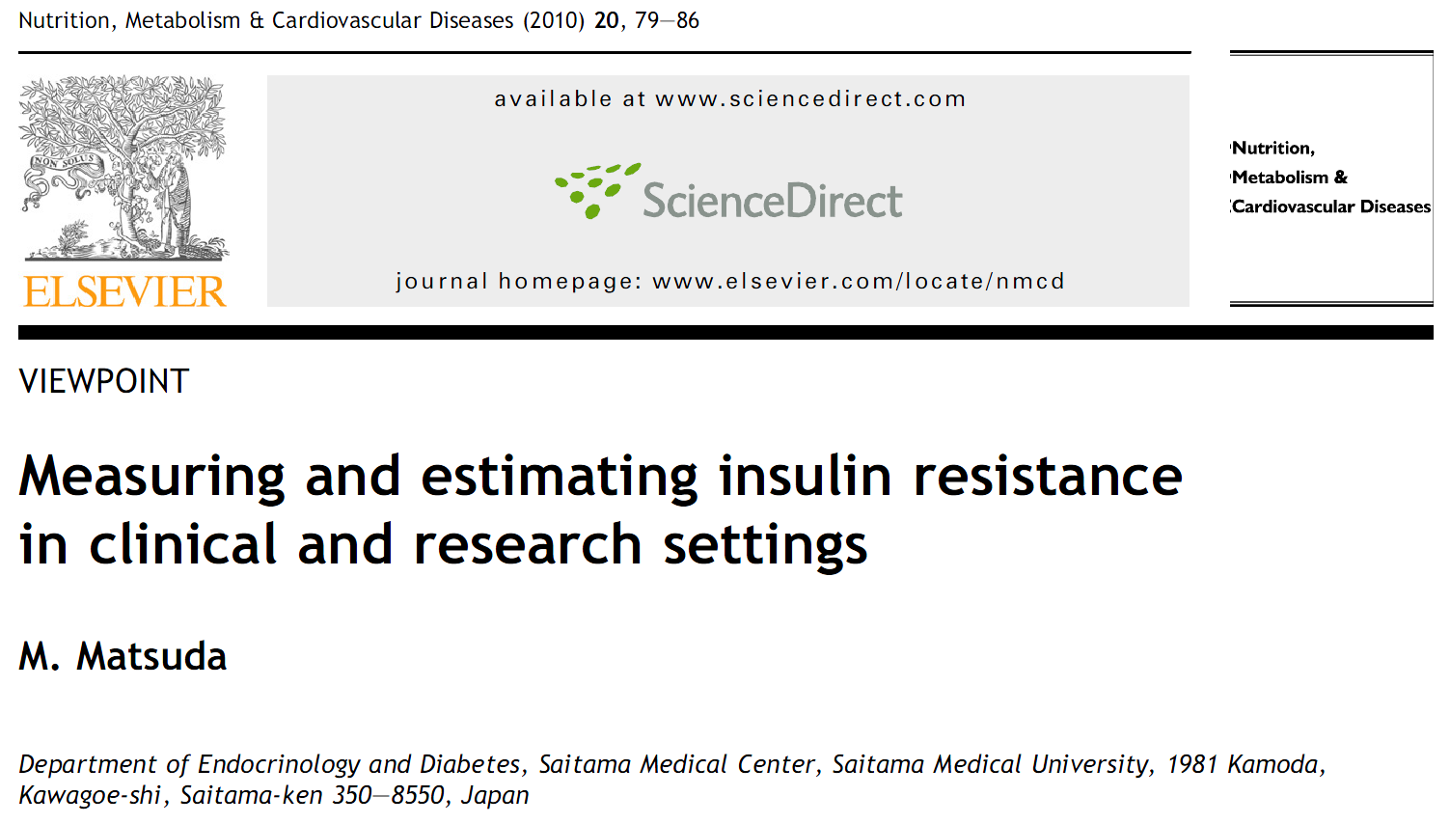
The slides are available from:
http://esicon2016pl.telemed.jp

Slide 5
Contents
The methods for the measurement of insulin resistance
What is HOMA-IR?
What is Matsuda index?
Why oral glucose tolerance test or meal tolerance test is required?
Limitations
Some substrates under investigation

Slide 6
Insulin Resistance
Resistance to “Insulin Treatment”
Failure to lower plasma glucose conc.
Himsworth HP: Diabetes mellitus: Its differentiation into insulin-sensitive and insensitive types. Lancet i:127-130, 1936.
More than 100 units per day
More than 1.4 units / kg body weight
Flier JS, Kahn CR, Roth J: Receptors, antireceptor antibodies and mechanisms of insulin resistance. N Engl J Med 300:413-9, 1979.
Resistance to “Insulin Action”
Insulin conc. was Higher in diabetic subjects !
Yalow R, Berson S: Immunoassay of endogenous plasma insulin in man. J Clin Invest 39:1157-1175, 1960.

Slide 7
Assessment of Insulin Resistance/Sensitivity
［Direct methods］
Lundbaek K: Intravenous glucose tolerance as a tool in definition and diagnosis of diabetes mellitus. Br Med J 1:1507-13, 1962. (Insulin loading: non-steady)
Insulin tolerance test
DeFronzo RA, Tobin J, Andres R: Glucose clamp technique: a method for quantifying insulin secretion and resistance. Am J Physiol 237:E214-E223, 1979. (insulin & glucose: steady)
Insulin clamp
［Indirect methods］
Turner RC, Holman RR, Matthews D, et al: Insulin deficiency and insulin resistance interaction in diabetes: estimation of their relative contribution by feedback analysis from basal plasma insulin and glucose concentrations. Metabolism 28:1086-1096, 1979. (Basal：steady)
HOMA-IR
Bergman RN, Ider YZ, Bowden CR: Quantitative estimation of insulin sensitivity. Am J Physiol 236:E667-E677, 1979.
(Glucose loading: non-steady)
Minimal model

Slide 8
Assessment of Insulin Resistance/Sensitivity
Gold standard : Euglycemic insulin clamp
Direct method
Steady state assessment (model free)
However,
Danger of hypoglycemia
(necessity of the attendance of a medical doctor)
Cumbersome procedure
Not physiological

Slide 9
Assessment of Insulin Resistance/Sensitivity
［Direct methods］
Lundbaek K: Intravenous glucose tolerance as a tool in definition and diagnosis of diabetes mellitus. Br Med J 1:1507-13, 1962. (insulin: non-steady)
Insulin tolerance test
DeFronzo RA, Tobin J, Andres R: Glucose clamp technique: a method for quantifying insulin secretion and resistance. Am J Physiol 237:E214-E223, 1979. (insulin & glucose: steady)
Insulin Clamp
［Indirect methods］
Matsuda M, DeFronzo RA: Insulin sensitivity indices obtained from oral glucose tolerance testing: comparison with the euglycemic insulin clamp. Diabetes Care 22:1462-1470, 1999. (Basal：steady & Glucose load: non-steady～steady)
Composite Index

Slide 10
Identify the degree of insulin resistance!
Fasting state;
A: | PG 90mg/dl | insulin 5μU/ml
B: | PG 90mg/dl | insulin 10μU/ml
C: | PG 120mg/dl | insulin 10μU/ml
Notes:
次のスライドお願いします。

Slide 11
Identify the degree of insulin resistance!
Fasting state;
Ratio Product
A: | PG 90mg/dl | insulin 5μU/ml | 90/5=18 | 90x5=450
B: | PG 90mg/dl | insulin 10μU/ml | 90/10=9 | 90x10=900
C: | PG 120mg/dl | insulin 10μU/ml | 120/10=12 | 120x10=1200
Answer: C, B, A
Notes:
次のスライドお願いします。

Slide 12
HOMA
Homeostatic Model Assessment

Slide 13


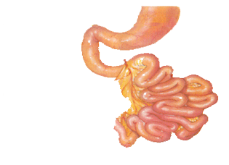
Control of Plasma Glucose
Pancreas
Adipocytes
Insulin
↑
Urinary glucose
Plasma Glucose
Blood Glucose
200 g/day
Glycogen
Glycogen
Lactic acid
Glycogen
Liver
Glycogen
Muscle
120g/day
Brain
(Food)
(Food)
Plasma glucose conc. is strictly controlled. Even small increase is out of this control.

Slide 14
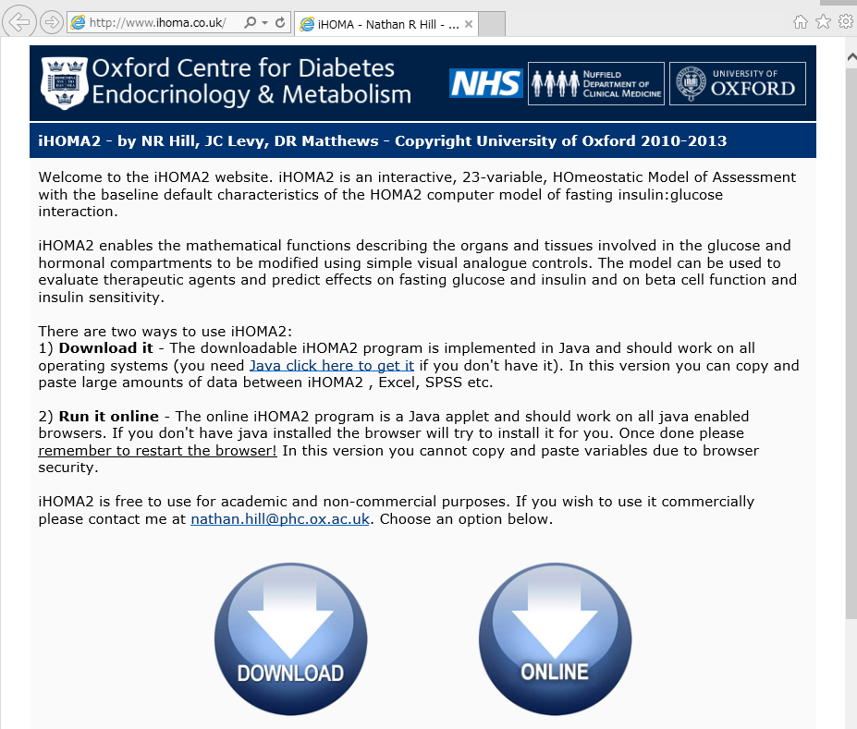
iHOMA2
Diabetes Care 36:2324-30, 2013.
http://www.ihoma.co.uk/

Slide 15
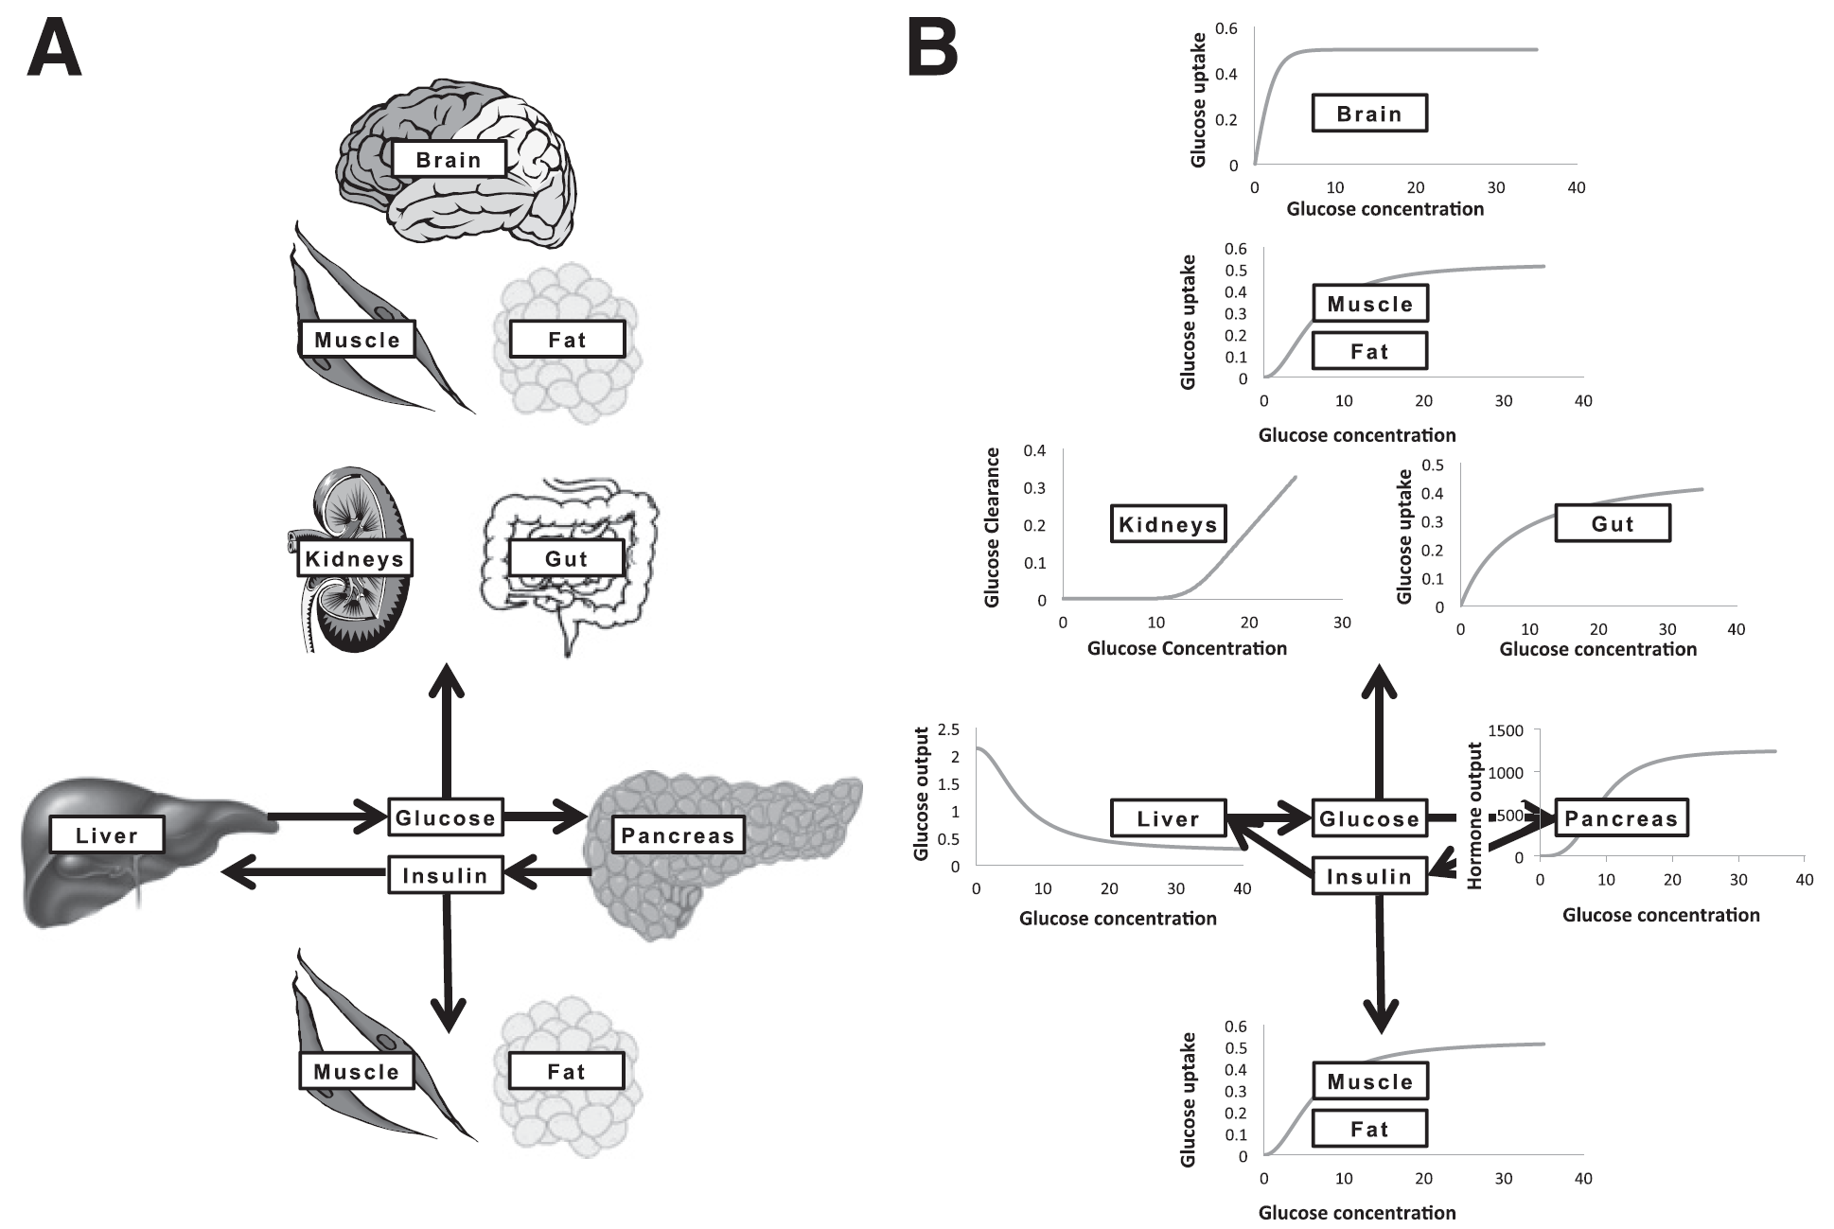
Concept of the iHOMA2

Slide 16
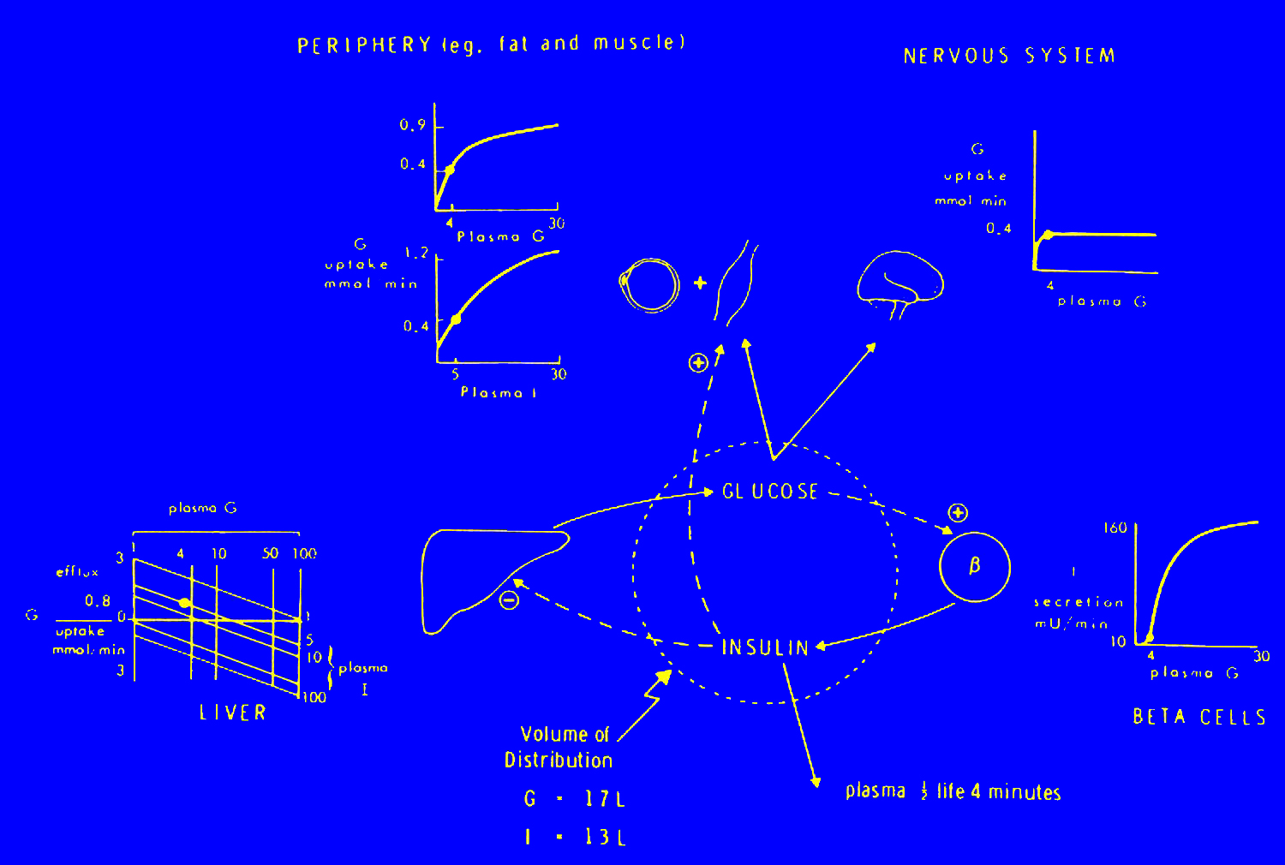
Original Description of the HOMA model
Metabolism 28:1086-1096, 1979
Notes:
次のスライドお願いします。

Slide 17
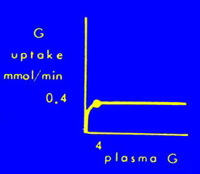
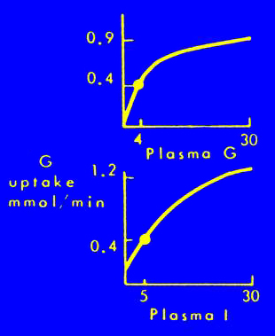
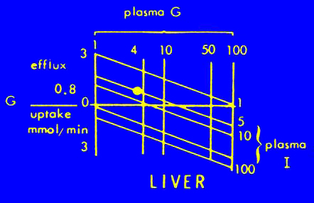
Original Description of the HOMA model
Brain
Peripheral
（Muscle etc.)
Liver
Metabolism 28:1086-1096, 1979
Notes:
次のスライドお願いします。

Slide 18
During the basal steady state:
0=
HGP & Splanchnic
(
f
PG,fIRI,rl) －
Brain
(fPG) －
Muscle
(fPG,fIRI, rp)
This is converted to the below formula. The unit of PG is mmol/min.
fIRI
fIRI
0.4
1.2
1
1
0=
×
log
0.4
1.2
1
1
0=
3-1.86
×
log
-1.5
×
log(fPG)
-
-
×
×
3-1.86
rl
-1.5
×
log(fPG)
-
0.1
-
×
×
rl
0.1
14
0.4
6
1+
14
0.4
1+
6
1+
1+
1+
1+
fPG
fPG
fIRI
fPG
fIRI
+2
fPG
rp
+2
rp
Where
fIRI : fasting insulin conc. [mU/L], fPG : fasting PG [mmol/L]
rl : liver insulin resistance, rp : peripheral (or muscle) insulin resistance
Assuming that rl=rp(=R), the above formula can be solved for R after substituting fPG and fIRI for actual measured values.
NOTE: The function above is valid in the steady state.
Notes:
次のスライドお願いします。

Slide 19
Calculation of HOMA-IR (example)
fIRI
fIRI
0.4
1.2
1
1
0=
×
log
0.4
1.2
1
1
0=
3-1.86
×
log
-1.5
×
log(fPG)
-
-
×
×
3-1.86
rl
-1.5
×
log(fPG)
-
0.1
-
×
×
rl
0.1
14
0.4
6
1+
14
0.4
1+
6
1+
1+
1+
1+
fPG
fPG
fIRI
fPG
fIRI
+2
fPG
fIRI=8 [μU/ml] , fPG=6 [mmol/L]
rp
+2
rp
Then,
8
0.4
1.2
1
1
0=
3-1.86
×
log
-1.5
×
log(6)
-
-
×
×
rl
0.1
14
0.4
6
1+
1+
1+
6
8
6
Thus,
+2
rp
rl ?, rp ? (when fIRI=8 μU/ml, fPG=108mg/dl(=6mmol/L))
M. Matsuda: index of insulin secretion and insulin resistance, Internal Medicine [Japanese] 105:39-44, 2010.
Notes:
次のスライドお願いします。

Slide 20
Calculation of HOMA-IR (example)
fIRI
fIRI
0.4
1.2
1
1
0=
×
log
0.4
1.2
1
1
0=
3-1.86
×
log
-1.5
×
log(fPG)
-
-
×
×
3-1.86
rl
-1.5
×
log(fPG)
-
0.1
-
×
×
rl
0.1
14
0.4
6
1+
14
0.4
1+
6
1+
1+
1+
1+
fPG
fPG
fIRI
fPG
fIRI
+2
fPG
rl=rp(=R)，fIRI=8 [μU/ml] , fPG=6 [mmol/L]
rp
+2
rp
Then,
8
0.4
1.2
1
1
0=
3-1.86
×
log
-1.5
×
log(6)
-
-
×
×
R
0.1
14
0.4
6
1+
1+
1+
6
8
6
Thus,
+2
R
R=2.1 (when fIRI=8 μU/ml, fPG=108mg/dl(=6mmol/L))
It was possible to solve this equation by a large frame computer in 1979. Now it is easy to solve this equation by an EXCEL file.
Note: this calculation was estimated from the figures found in the original Metabolism paper published in 1979. It may possible that Dr. Turner used a different formula.
M. Matsuda: index of insulin secretion and insulin resistance, Internal Medicine [Japanese] 105:39-44, 2010.
Notes:
次のスライドお願いします。

Slide 21
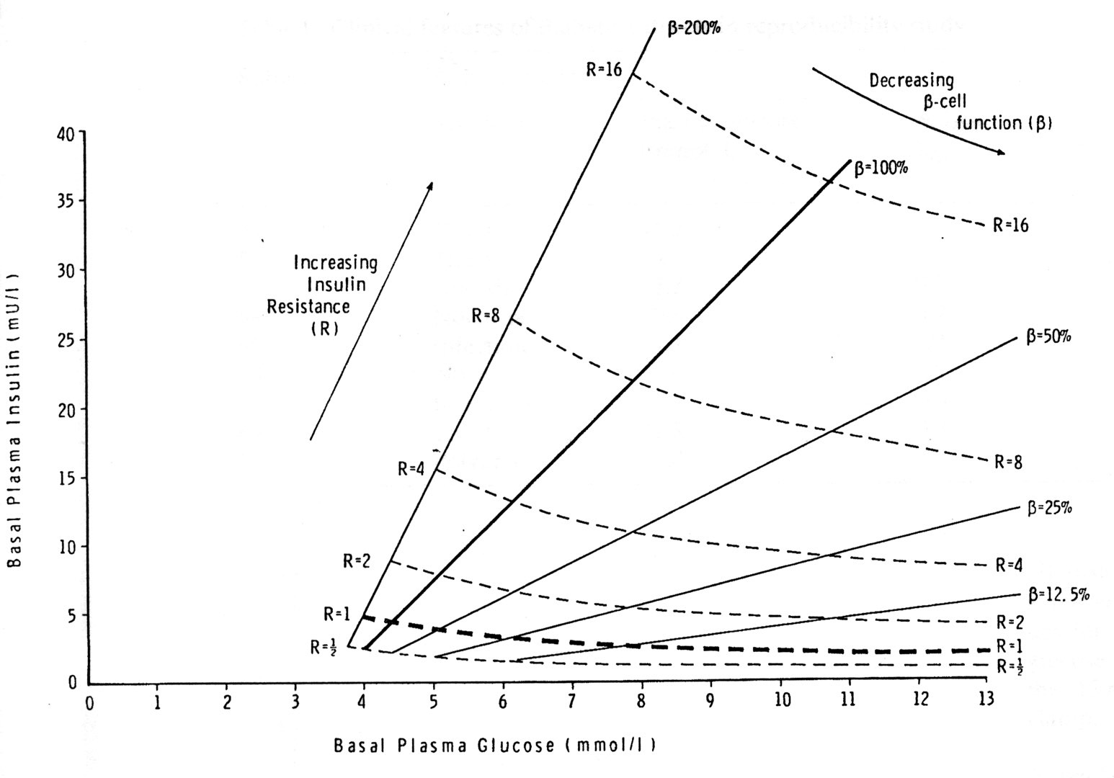
Induction of Simplified HOMA formula
Reduced formula
Fasting
Insulin
(1985 by Matthews D et al.)
HOMA-IR=
HOMA-β%=
FPG
Approximation of HOMA-IR and HOMA-β%
Diabetologia 28:412-419, 1985
Notes:
次のスライドお願いします。

Slide 22
rp: peripheral insulin resistance
rl: liver insulin resistance
Product of FPG and fasting insulin conc. (on y-axis) is almost equal to the HOMA-IR calculated by the model proposed by Turner et al, 1979 (n x-axis).
Expressed by •
Please neglect the connection lines.

Slide 23
Induction of HOMA-IR (1)
Valid for glucose utilization
Insulin sensitivity
positive constant
plasma glucose, insulin conc.
the fractional disappearance rate of glucose
(insulin action)
the volume of distribution of glucose
the glucose input rate
(Radziuk J: J Clin Endocrinol Metab 85: 4426-4433, 2000)

Slide 24
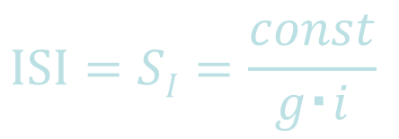
Induction of HOMA-IR (2)
Valid for glucose utilization
Steady state:
Insulin sensitivity （steady state）
(Radziuk J: J Clin Endocrinol Metab 85: 4426-4433, 2000)

Slide 25



QUICKI and HOMA %S
$$QUICKI=\frac{1}{log(I0×G0)}=\frac{1}{log(22.5×HOMA−IR)}$$
Kats A, Nambi SS, Mather K et al: Quantitative Insulin-Sensitivity Check Index (QUICKI): a simple, accurate method for assessing insulin sensitivity in humans. J Clin Endocrinol Metab 85:2402-2410, 2000.
$$HOMA \%S=\frac{100}{HOMA−IR}$$
Wallace TM, Levy JC, Matthews DR.: Use and abuse of HOMA modeling. Diabetes Care 27:1487-95, 2004.
The computer model gives a value for insulin sensitivity expressed as HOMA2-%S (where 100% is normal), which is simply the reciprocal of HOMA2-IR.

Slide 26
Improvement of HOMA
●Whole body insulin sensitivity
Matsuda Index
●Specificity to the liver and the muscle
Modified HOMA

Slide 27
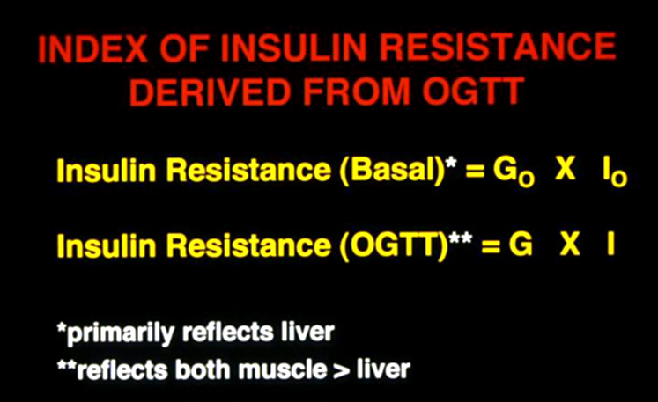
Introduction of Matsuda index
Depicted by Dr. Ralph A. DeFronzo.
Notes:
次のスライドお願いします。

Slide 28
After glucose administration
MCR (metabolic clearance rate)
Dose of glucose
AUC of PG conc.
(non- steady state)
=
Glucose Dose
PG
mean
MCR
0
~180min

Slide 29
After glucose administration
Insulin Sensitivity during OGTT
MCR of glucose
Average Insulin conc.
Dose of glucose
PG × Insulin
can be estimated by
=

Slide 30
Induction of Matsuda index
Inverse of Geometric Mean
Notes:
次のスライドお願いします。

Slide 31
Insulin sensitivity indices obtained from oral glucose tolerance testing
10,000
ISI(comp)=
(FPG×FPI)×(G×I)
1
∫
240
G=
g(t)
dt
240
mean
0
1
∫
240
I=
i(t)
dt
240
0
0
240
Response up to 240 minutes or time that is necessary to reach basal state.
Matsuda M, DeFronzo RA.: Diabetes Care 22(9):1462-70, 1999.
Notes:
次のスライドお願いします。

Slide 32
Insulin sensitivity indices obtained from oral glucose tolerance testing
10,000
ISI(comp)=
(FPG×FPI)×(G×I)
1
∫
120
G=
g(t)
dt
120
mean
0
1
∫
120
I=
i(t)
dt
120
0
0
120
Usually we have OGTTs with 120 minutes. And the initial validation was done from the data up to 120 min.
Matsuda M, DeFronzo RA.: Diabetes Care 22(9):1462-70, 1999.
Notes:
次のスライドお願いします。

Slide 33
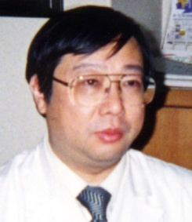
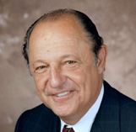
ISI(comp)
(Composite Index, Matsuda’s Index)
Mean (range, ±SD) in healthy young persons
New Haven, CT (n=37) 5.43 (2.7-9.6, ±1.9)
San Antonio, TX (n=62) 4.34 (1.0-11.0, ±2.6)
Correlation with clamp: r ≧ 0.73
Matsuda M, DeFronzo RA: Insulin sensitivity indices obtained from oral glucose tolerance testing. Comparison with the euglycemic insulin clamp. Diabetes Care 22: 1462-1470, 1999.

Slide 34
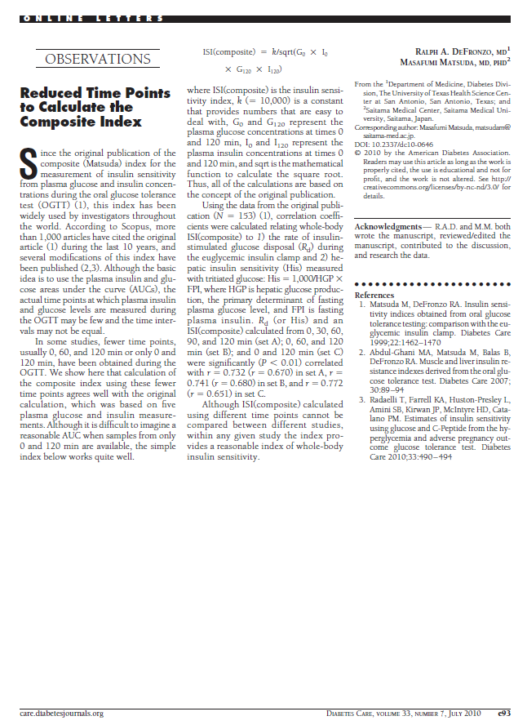
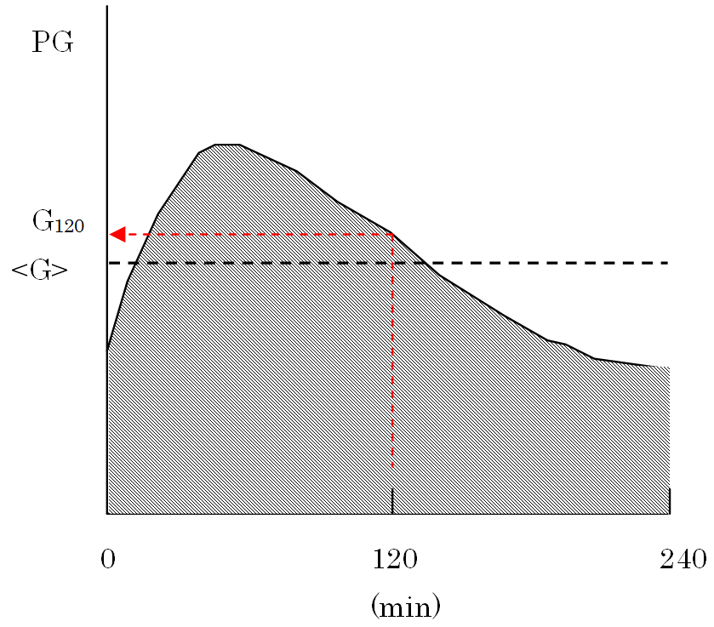
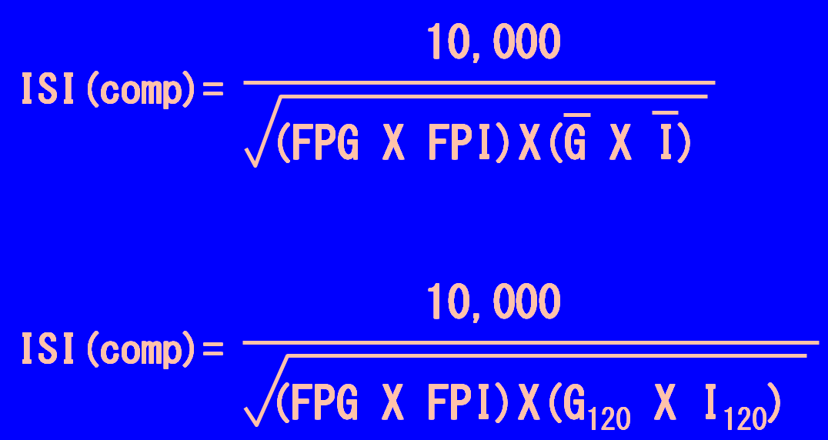

Slide 35
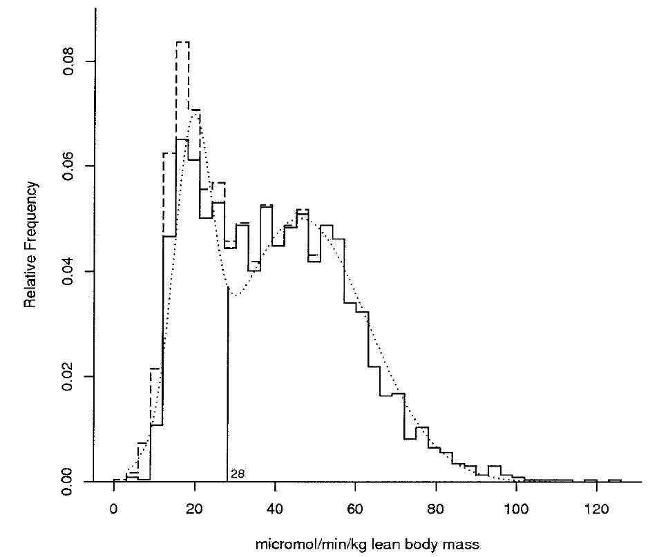
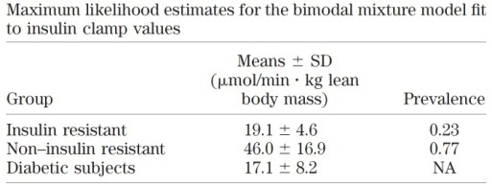
Cut off value for Insulin Resistance
2,321 (2,138 nondiabetic) euglycemic insulin clamp studies
European Group for the Study of Insulin Resistance (EGIR) project (n = 1,436)
Pima Indian Study (n = 597)
San Antonio (n = 288, of whom 99 were Mexican American)
The EGIR studies were performed on Caucasians from 17 European sites (Athens, Greece; Baden, Heidelberg, Kreisha, and Munich,Germany; Belgrade, Serbia; Geneva, Switzerland; Goteborg, Sweden; Helsinki and Kuopio, Finland; Odense, Denmark; and Naples, Padova, Pisa, Rome,Torino, and Verona, Italy).
Mixture model for whole-body glucose disposal measured by the euglycemic insulin clamp technique. Dashed line, histogram including diabetic subjects; solid line, histogram excluding diabetic subjects; dotted line, normal mixture density estimate.
Cut off Value
Rd: <28 mmol/min per kg LBM
(5.0 mg/min per kg LBM)
(200 mg/min per m²)
ISI(comp): < ~ 3.1
HOMA-IR: > ~ 2.8
Diagnosis of insulin resistance
(if any of the following conditions are met)
BMI >28.9 kg/m²
HOMA-IR>4.65
BMI >27.5 kg/m²
and HOMA-IR >3.60
(Sensitivity 84.9%, Specificity 78.7%)
Insulin Sensitivity
Diabetes 54:333–339, 2005

Slide 36
Cut off Value Calculation
from the data set used to introduce ISI(comp)
Rd<200mg/m² per min as the gold standard
Sensitivity Specificity
BMI≧28.0 83% 65%
BMI≧30.0 66% 80%
(Rd vs BMI: r=-0.45)
HOMA-IR≧2.50 84% 69%
HOMA-IR≧2.80* 80% 77%
(Rd vs HOMA-IR: r=-0.44)
ISI(comp)＜3.1 76% 71%
ISI(comp)＜2.6* 71% 84%
(Rd vs ISI(comp): r=0.73)
Model 91% (85%¶) 62% (79%¶)
BMI >28.9 kg/m² or HOMA-IR>4.65 or (BMI >27.5 kg/m² and HOMA-IR >3.6)
*:best value by ROC analysis
¶: shown in Diabetes 54:333–339, 2005
(Data set used in Diabetes Care 22: 1462, 1999)
ISI(comp)=2.5 was used as a cut-off in Kerman WN, et al: Pioglitazone improves insulin sensitivity among non diabetic patients with a recent transient ischemic attach or ischemic stroke. Stroke 34:1431-6, 2003

Slide 37
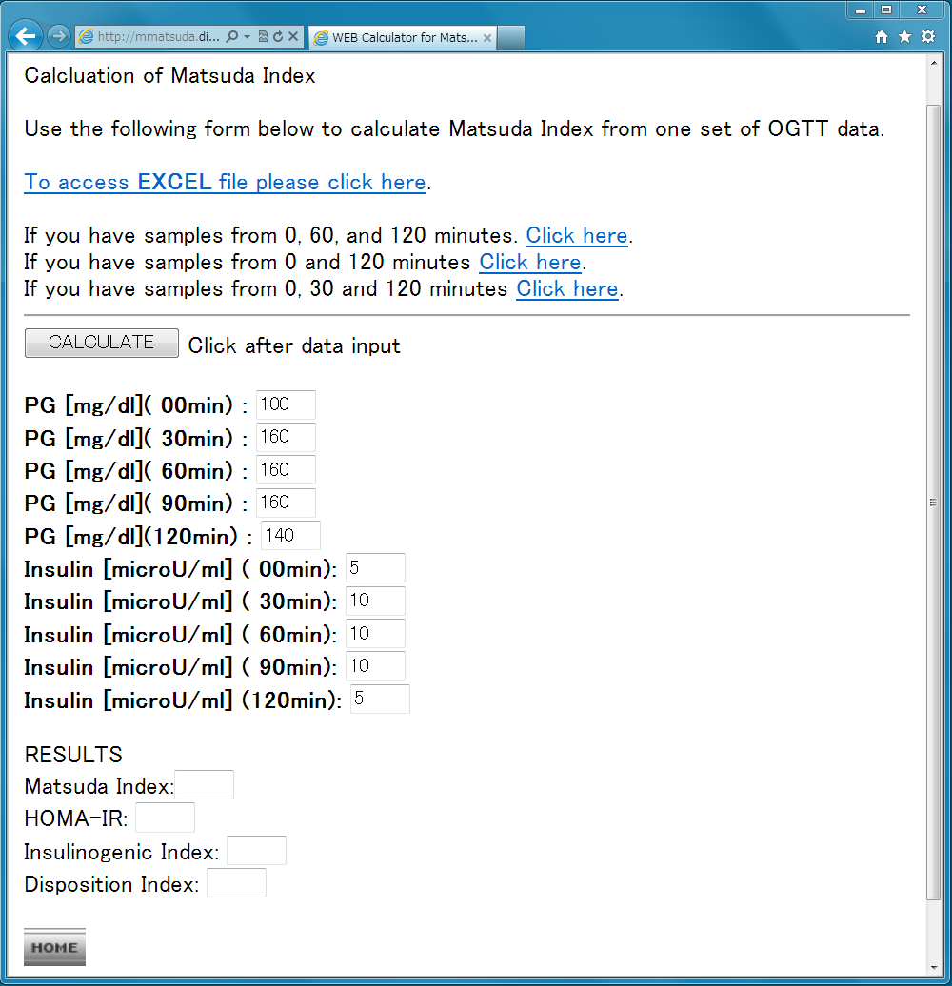
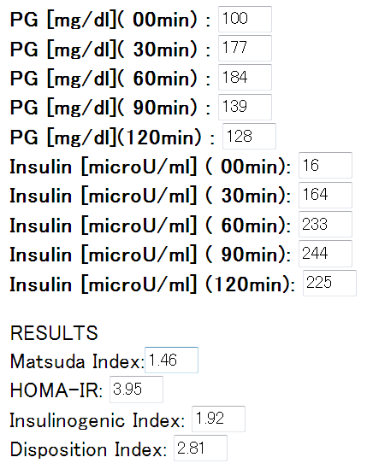
(whole body insulin resistant: equal or lower than 2.5, normal range: 5~8)
(normal: lower or equal to 1.6, liver insulin resistant: equal or more than 2.5.)
(defect in insulin secretion: less than 0.4)
(product of insulinogenic index and Matsuda index: normal: more than 1)
http://mmatsuda.diabetes-smc.jp/MIndex.html

Slide 38
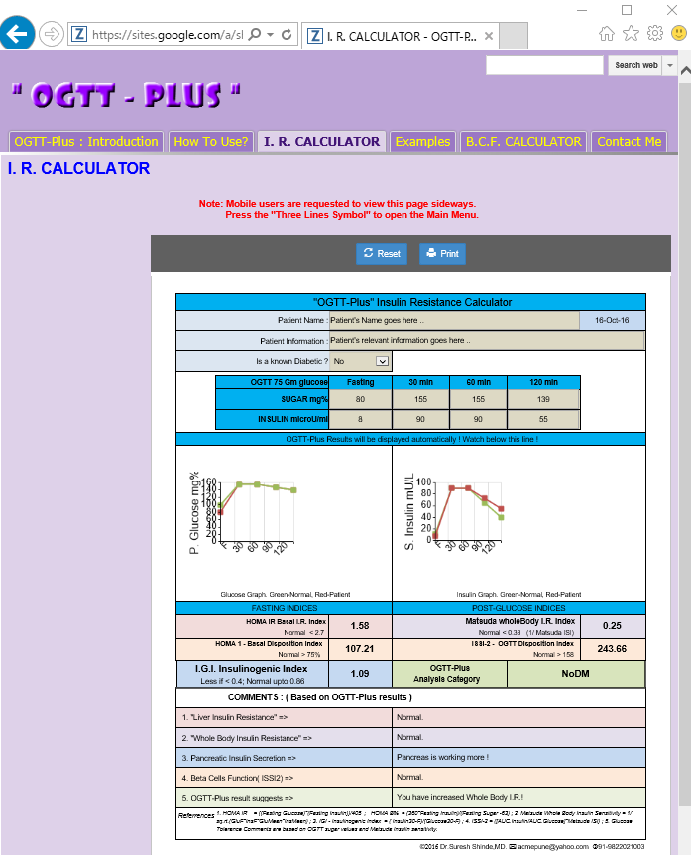
http://www.ogttplus.com
©2016 Dr.Suresh Shinde,MD.

Slide 39
HOMA-IR and Matsuda index when a SGLT-2 inhibitor is used.
(108mg/dL)
(108mg/dL)

Slide 40
Letter from Dr. Matthews:
Subject: Re: HOMA-IR under use of SGLT-2 inhibitors
Hi,
HOMA doesn't give the correct answer when used with SGLT2 inhibitors since the effect of insulin appears greater as more glucose is cleared... So you need to use iHOMA, and change the renal threshold appropriately as described in our Diabetes Care paper:
Hill NR, Levy JC, Matthews DR. Expansion of the homeostasis model assessment of beta-cell function and insulin resistance to enable clinical trial outcome modeling through the interactive adjustment of physiology and treatment effects: iHOMA2. Diabetes Care. 2013; 36:2324-30.
Best wishes
David
Prof. David R. Matthews
Professor of Diabetes Medicine, University of Oxford Emeritus Chairman, Oxford Centre for Diabetes, Endocrinology and Metabolism (OCDEM).
Medical tutor, Harris Manchester College, Oxford

Slide 41
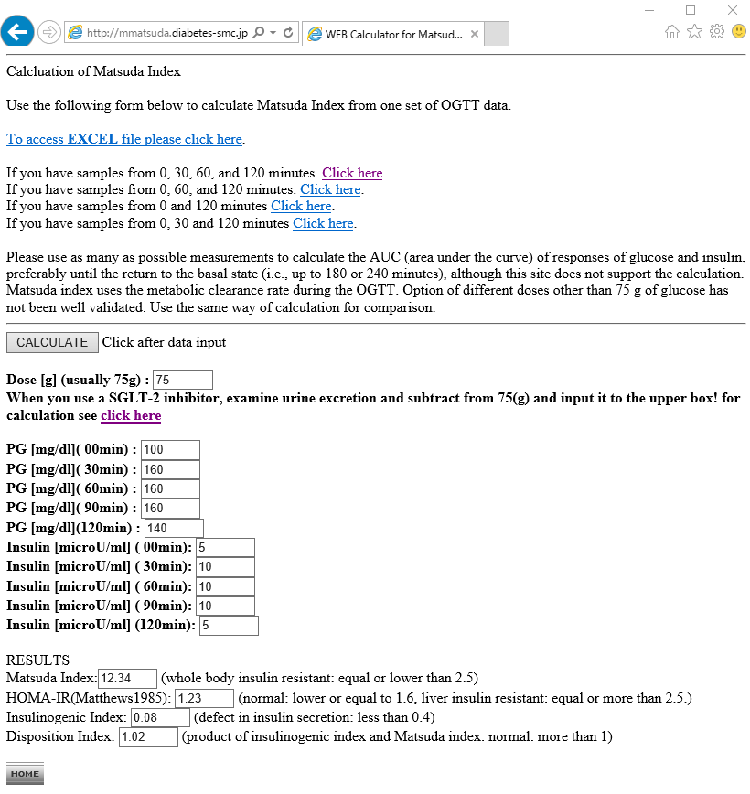
http://mmatsuda.diabetes-smc.jp/MIndex.html

Slide 42
OGIS
(Other methods 1)
Mari A et al: A model-based method for assessing insulin sensitivity from the oral glucose tolerance test. Diabetes Care 24: 539-548, 2001.

Slide 43
SI(OGTT)
(Other methods 2)
Breda E, Cavaghan MK, Toffolo G, Polonsky KS, Cobelli C: Oral glucose tolerance test minimal model indexes of beta-cell function and insulin sensitivity. Diabetes 50: 150-158, 2001.

Slide 44

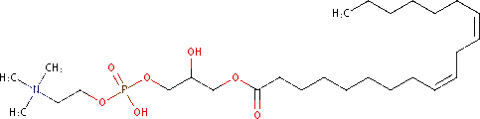

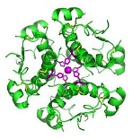
Is an OGTT necessary?
The Quantose M index (M^{Q}) is derived from a multiple linear regression based on fasting measurements (logarithmically transformed) of plasma α-HB (α-hydroxybutyrate), L-GPC (linoleoyl-glycerophosphocholine), oleic acid, and insulin, as previously described. We chose the metabolites which had the highest correlation (r) with insulin sensitivity obtained from hyperinsulinemic euglcyemic clamp studies insulin – 0.53, α-HB –0.36, L-GPC 0.33, and oleate –0.22. M^{Q} is designed to estimate the clamp-derived M value.
Cobb J, Ferrannini E et al: A novel fasting blood test for insulin resistance and prediabetes. J Diab Sci Tech. 2013;7:100–110.
10- and 12-(Z,E)-hydroxyoctadecadienoic acids (HODE)
Umeno A, Yoshida Y et al.: Singlet oxygen induced products of linoleates, 10- and 12-(Z,E)-hydroxyoctadecadienoic acids (HODE), can be potential biomarkers for early detection of type 2 diabetes. PLoS One. 2013 May 15;8(5):e63542.

Slide 45
Figure 2. Relationship between close-out changes in Quantose MQ and Matsuda Index in subjects randomized to pioglitazone or placebo. The best fit is linear in both groups (r=0.69, P <0.0001 for pioglitazone, and r=0.77, P<0.0001 for placebo); the fitted line for the pioglitazone group is significantly (P<0.01) different from that of the placebo group.
J Clin Endocrinol Metab. 2015 May;100(5):1855-62.

Slide 46
Summary
Euglycemic insulin clamp is a gold standard for the measurement of insulin resistance.
However, the method is not physiological.
HOMA is a good method to measure hepatic insulin resistance.
Matsuda index actually measures whole body insulin resistance including muscle contribution.
This OGTT-based measurement is physiological.
HOMA-IR cannot be used with SGLT-2 inhibitors. Matsuda index also needs correction by collecting urine sample after an OGTT.
For the estimation of insulin resistance from a fasting blood sample, some substrates were under investigation.

Slide 47
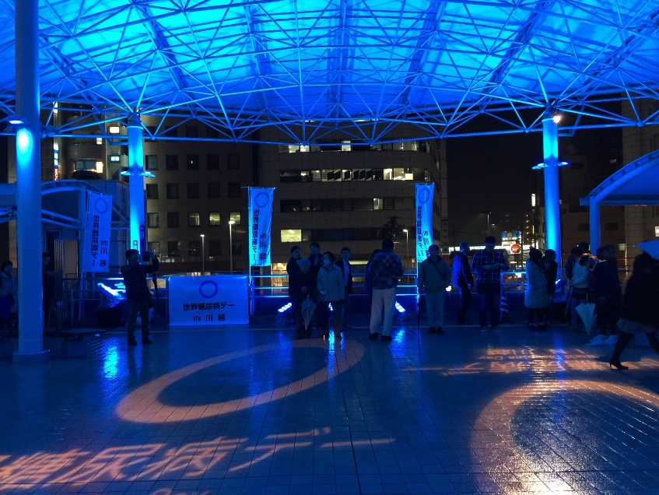
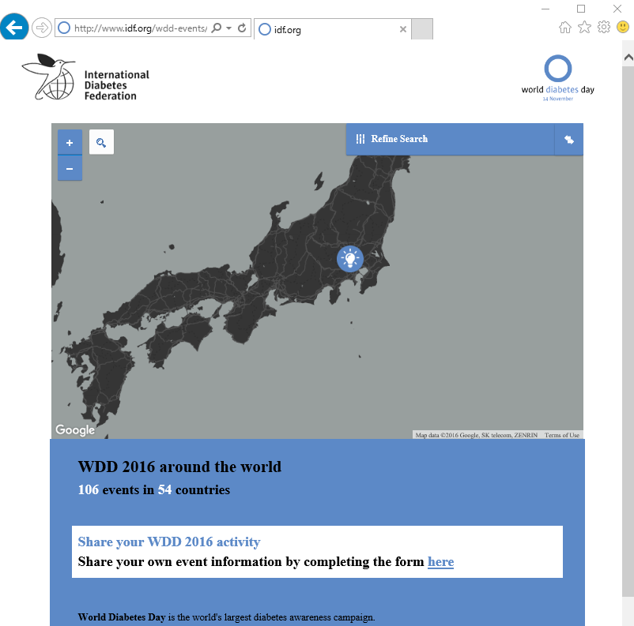
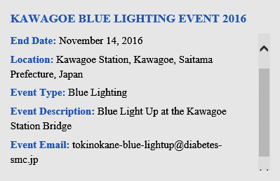
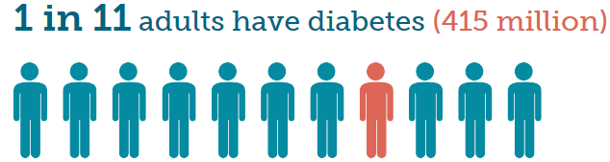
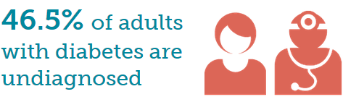
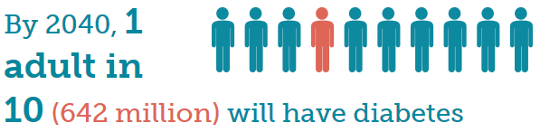
2015年11月14日
http://www.diabetesatlas.org/key-messages.html
http://tokinokane-blue-lightup.diabetes-smc.jp/forpc.html

